Slide 1
FYP-1 Proposal Defense
Group Members:
Inam Gul
Syed Ammar Mahmood
Muhammad Bilal Ashfaq

Slide 2



MOTIVATION BEHIND DOING THIS PROJECT?

Slide 3


LOCATION BASED MARKETING

Slide 4
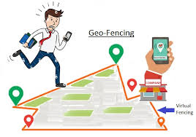

KEY PILLARS OF LBM
GEO FENCING
GEO TARGETING
GEO CONQUEST
BEACONS TECHNOLOGY

Slide 5



Slide 6


Slide 7

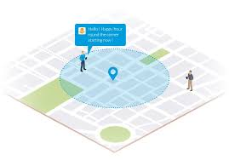
DESCRIPTION OF THE PROJECT

Slide 8
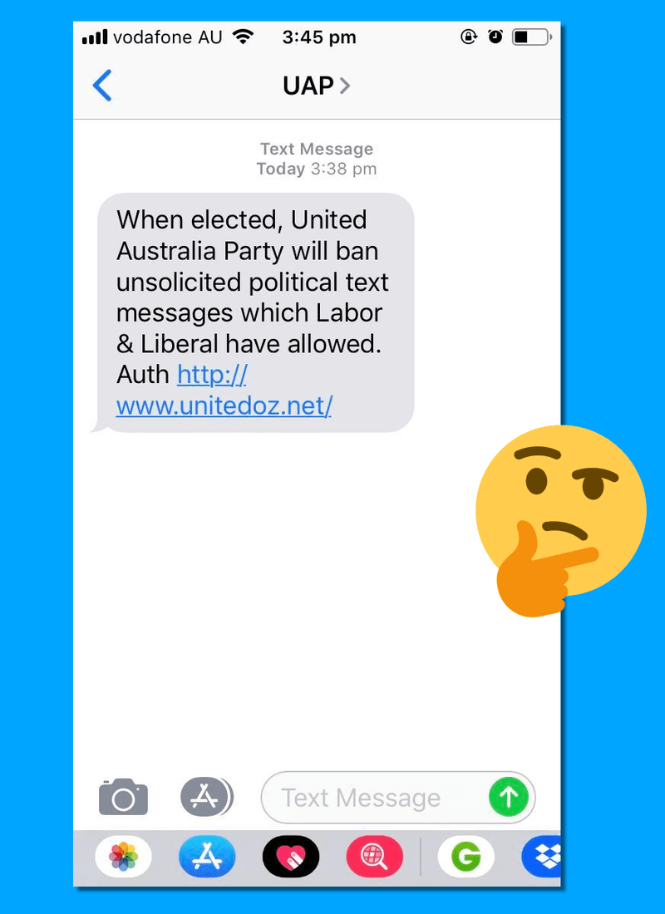


WHAT WILL BE THE IMPACT OF THIS PROJECT?

Slide 9

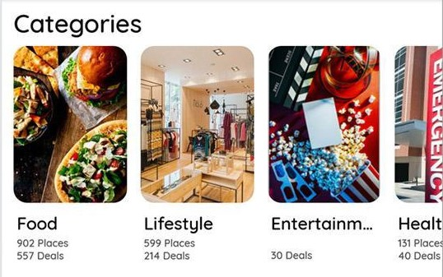

FEATURES
Announcements in targeted areas
Create push notification for targeted audience
Location update via backend service
Search for the best options in categories
Location prediction algorithm design for location tracing

Slide 10
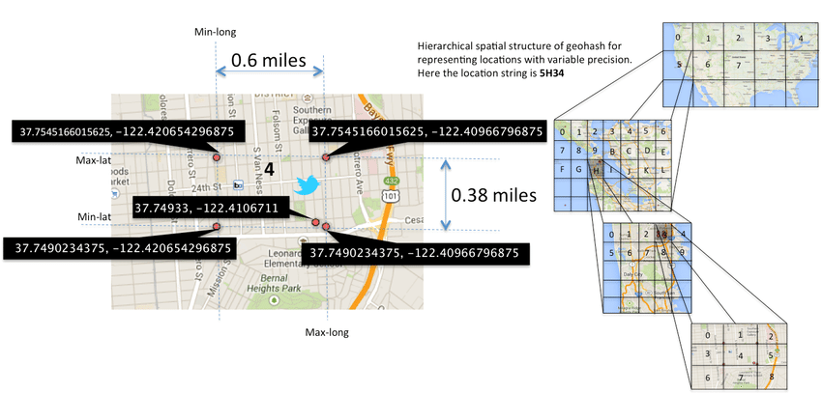
FEATURES
Geo Hashing

Slide 11
Architecture
Hybrid Architecture
Repository Architecture
Client Server Architecture

Slide 12
WHY REPOSITORY ARCHITECTURE?
Efficient way to share large amounts of data
Centralized Management that take control of backup, integrity and security
Integrate two databases Firebase and SQL Server
Maintain the workflow

Slide 13
WHY CLIENT-SERVER ARCHITECTURE?
Organize the Client and server in set of layers each provide set of services
Data Encryption attain successfully
Message broadcast will be easy through server
Scalability

Slide 14
ARCHITECTURAL DIAGRAM

Slide 15
ITERATIVE MODEL

Slide 16
ADVANTAGES OF ITERATIVE MODEL
In this model requirements are flexible
In each Project iteration, result is obtained
Risk analysis will be better
Program will be Verified and Maintained
By using this architecture customer will facilitate and easily evaluate and give their feedback

Slide 17
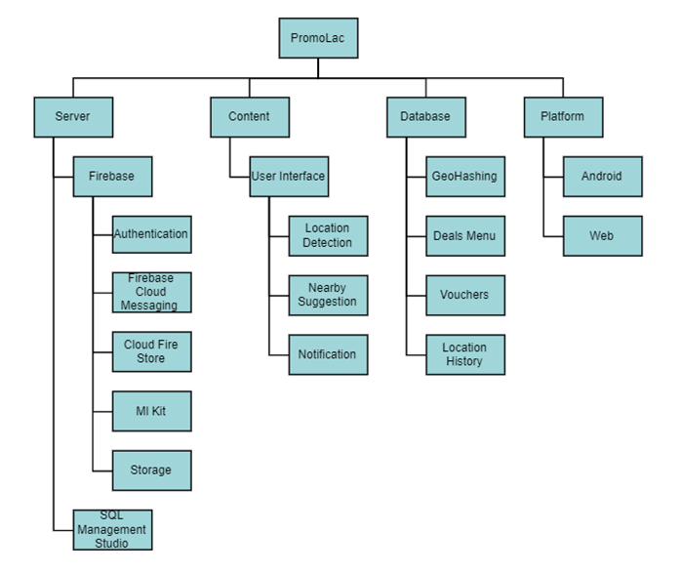
WORK BREAKDOWN STRUCTURE

Slide 18
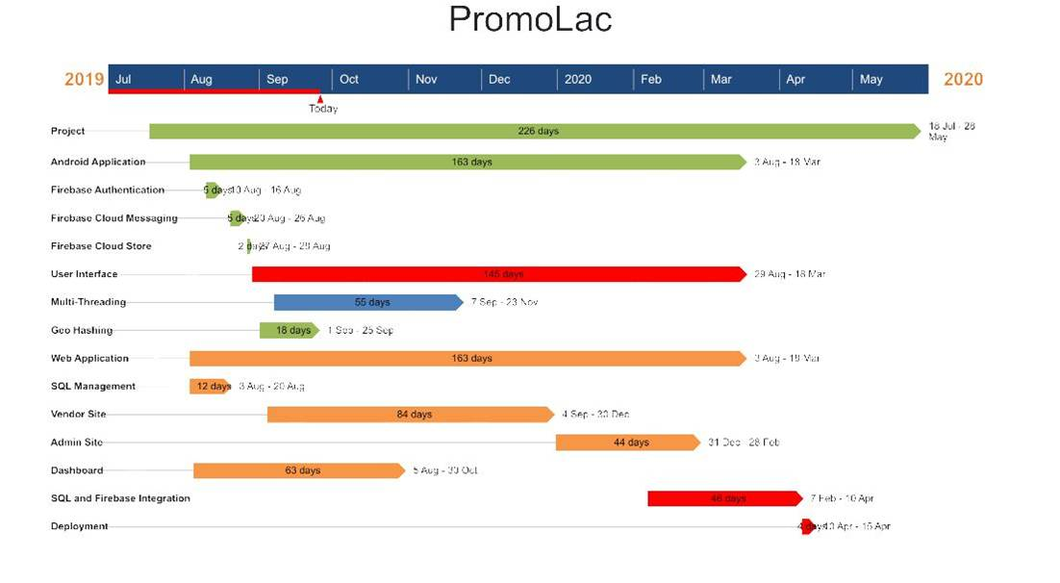
GANTT CHART

Slide 19

Thanks For Your Attention

